Slide 1


WEATHER MONITORING
Experiment 3
Raphael S. Nano
CPE161P / A1
Computer Engineering Department
School of Electrical, Electronics, and Computer Engineering
Notes:
Good day to everyone! My name is Raphael S. Nano from section A1 for CPE161P, presenting experiment 1 – the Real-time basketball scoreboard.

Slide 2
Introduction: Weather Monitoring
Real-time weather monitoring systems are prevalent applications in mobile embedded systems
With the use of continuous monitoring and prediction of weather patterns, these systems serve as the center for meteorological expertise, as they collect and analyze parameters with speed and precision.
Through a set of sensors and grounded measuring instruments, they cover a wide range of analysis for the weather reports.
Notes:
Basketball is a sport played on a rectangular court by two teams of five players each, generally indoors. Each side attempts to score by tossing the ball through the opposing goal, which is an elevated horizontal hoop and net known as a basket. Shooting at different areas of the court would mean different points. If the shooter scores while outside the 3-point line, their team gets 3 points. If the shooter scores within the 3-point line, their team gets 2 points. Free throws, on the other hand, gives them 1 point. Knowing that, a real-time basketball scoreboard will be constructed and programmed, wherein 1, 2, or 3 points could be added or deducted every time a ball went in the basket.

Slide 3
Weather Monitoring
With that being said, a simple weather monitoring system was developed using the Arduino Uno as the center, temperature sensor for the input, and LCD for the display of values.
Notes:
Basketball is a sport played on a rectangular court by two teams of five players each, generally indoors. Each side attempts to score by tossing the ball through the opposing goal, which is an elevated horizontal hoop and net known as a basket. Shooting at different areas of the court would mean different points. If the shooter scores while outside the 3-point line, their team gets 3 points. If the shooter scores within the 3-point line, their team gets 2 points. Free throws, on the other hand, gives them 1 point. Knowing that, a real-time basketball scoreboard will be constructed and programmed, wherein 1, 2, or 3 points could be added or deducted every time a ball went in the basket.

Slide 4
Objectives
To demonstrate how a weather monitoring system works in real-time.
To be able apply what you have learned in logic circuits and switching theory, microprocessors, and CPE160P.
To be able to apply real-time embedded system using Arduino kit.
Notes:
The objectives of this experiment are the following:
1. To demonstrate how a score board for a basketball game works in real-time.
2. To be able to apply what you have learned in logic circuits and switching theory, microprocessors, and CPE160P.
3. To be able to apply real-time embedded systems using the Arduino kit.

Slide 5
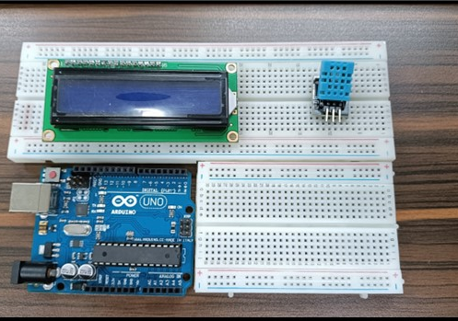
Materials
Hardware
Arduino Kit
Arduino Uno
DHT11 Temperature and Humidity Sensor
Liquid Crystal Display with I2C
Notes:
The materials utilized to construct the real-time basketball scoreboard are the Arduino UNO, the 4-digit seven segment display, and 5 switch buttons.

Slide 6
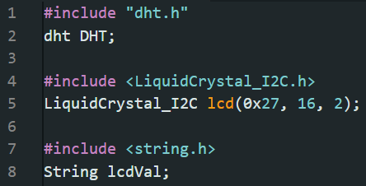
Materials
Software Libraries
dht.h
LiquidCrystal_I2C.h
string.h
Notes:
For the external library, only the SevSeg.h was used, which is for the seven segment display.

Slide 7
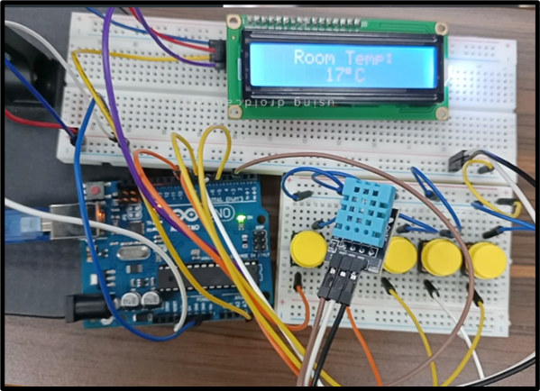
Discussion: Weather Monitoring
Main Objective: To simulate a weather monitoring system that operates in real-time
5 areas or conditions:
  Room
  Hands
  Outside a room
  Inside the bag
  Comfort room
Notes:
The first experiment primarily aims to demonstrate how a scoreboard for a basketball game works in real-time. Hence, there should be no delay in adjusting or changing the values of the seven-segment display every time a button was pushed down.
Two functions were used for the adjusting of points since there are two teams to be handled. So, team1() function is used for the adding or subtracting of values for the first two digits of the 4-digit seven segment display. On the other hand, team2() function is used to adjust the values for the rightmost two digits for the seven segment display. Although there are two separate functions, their purpose is the same, and only the digits to be considered are different.

Slide 8
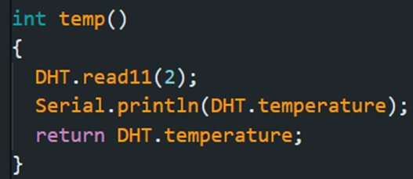
Discussion: Weather Monitoring
DHT11 is activated using the read11() function
temp() was constructed to return the value of the sensed temperature using the DHT.temperature
Notes:
The first experiment primarily aims to demonstrate how a scoreboard for a basketball game works in real-time. Hence, there should be no delay in adjusting or changing the values of the seven-segment display every time a button was pushed down.
Two functions were used for the adjusting of points since there are two teams to be handled. So, team1() function is used for the adding or subtracting of values for the first two digits of the 4-digit seven segment display. On the other hand, team2() function is used to adjust the values for the rightmost two digits for the seven segment display. Although there are two separate functions, their purpose is the same, and only the digits to be considered are different.

Slide 9
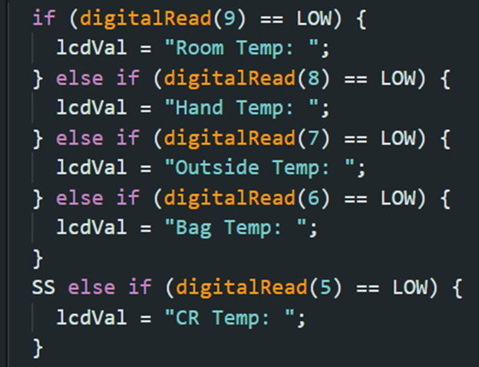
Discussion: Weather Monitoring
"Weather Monitoring" will be first displayed
5 buttons were added
  One for each area/condition
string lcdVal will be initialized with that specific value
Notes:
The first experiment primarily aims to demonstrate how a scoreboard for a basketball game works in real-time. Hence, there should be no delay in adjusting or changing the values of the seven-segment display every time a button was pushed down.
Two functions were used for the adjusting of points since there are two teams to be handled. So, team1() function is used for the adding or subtracting of values for the first two digits of the 4-digit seven segment display. On the other hand, team2() function is used to adjust the values for the rightmost two digits for the seven segment display. Although there are two separate functions, their purpose is the same, and only the digits to be considered are different.

Slide 10
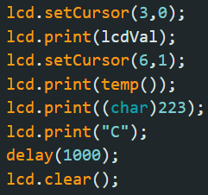
Discussion: Weather Monitoring
For display of values, LCD uses print() function to display the sensed temperature with the temp() module
(char)223 was used for the degree symbol
A “C” was printed after the degree symbol
Notes:
The first experiment primarily aims to demonstrate how a scoreboard for a basketball game works in real-time. Hence, there should be no delay in adjusting or changing the values of the seven-segment display every time a button was pushed down.
Two functions were used for the adjusting of points since there are two teams to be handled. So, team1() function is used for the adding or subtracting of values for the first two digits of the 4-digit seven segment display. On the other hand, team2() function is used to adjust the values for the rightmost two digits for the seven segment display. Although there are two separate functions, their purpose is the same, and only the digits to be considered are different.

Slide 11
Conclusion
The weather monitoring system works in two functions:
  Detection of temperature using DHT11
    Reads the value using read11()
    Returns DHT.temperature
  Display of values
    Shows title using LCD.print()
    Displays value returned by temp()

Slide 12
Conclusion
As the second objective was achieved, the use of microprocessors, logic circuits, and switching theory, as well as the teachings in CPE160P, was shown using series connections, pin arrangements, and sensor and LCD activation.
To achieve the third objective, the real-time weather monitoring system was successfully constructed and shown in a basic handshaking by applying various variables, modules, and invoking such functions to design an embedded system.

